Slide 1
Docker II
- Kranthi Kavuri

Slide 2
Running A Container
docker search <Application/Container name>
Ex: docker search jenkins
docker run –d <Container name>
Ex: docker run –d Jenkins
docker run –d <Container Name>:<Version>
Ex: docker run –d Jenkins:latest

Slide 3
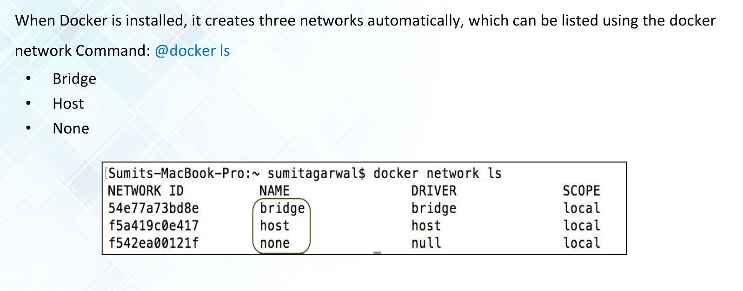
Default Networks

Slide 4
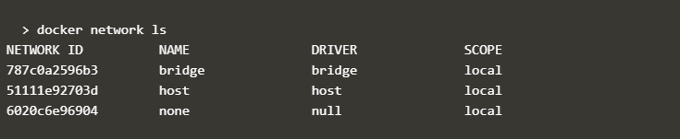

Slide 5
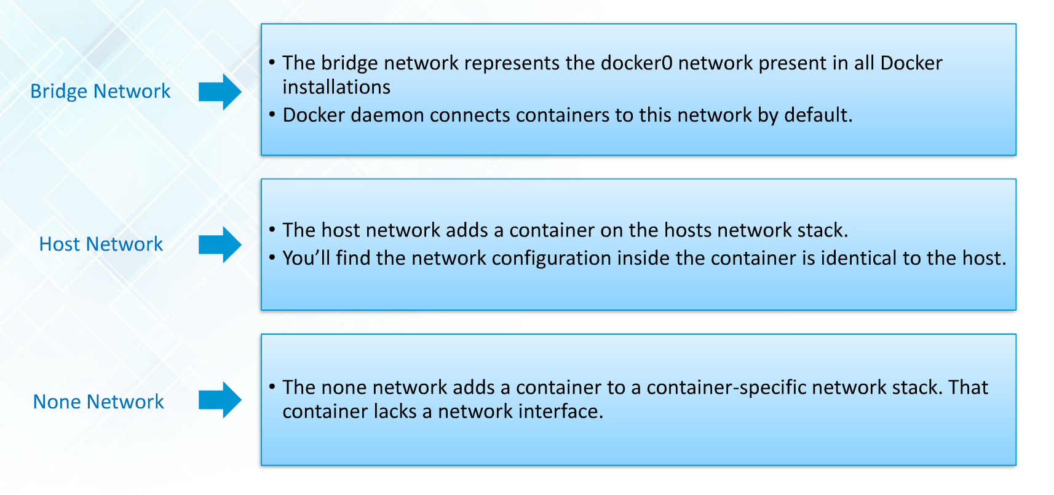
Networks types

Slide 6
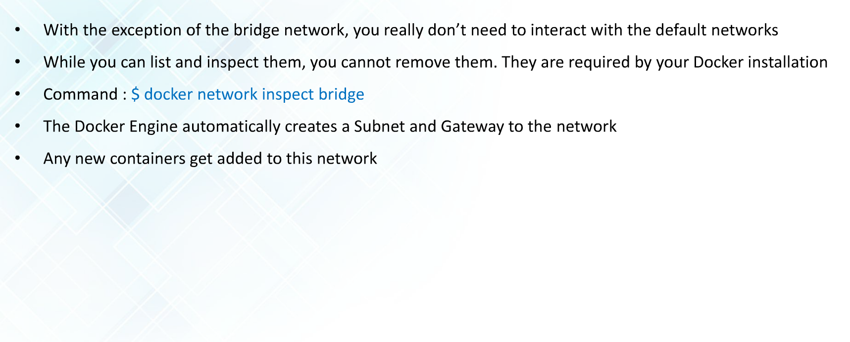
Default Bridge Network Details

Slide 7
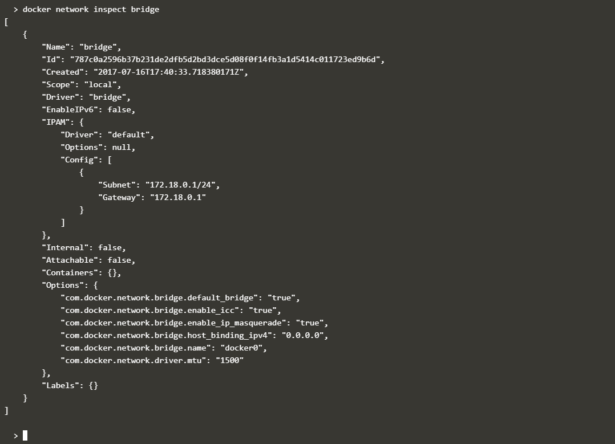

Slide 8
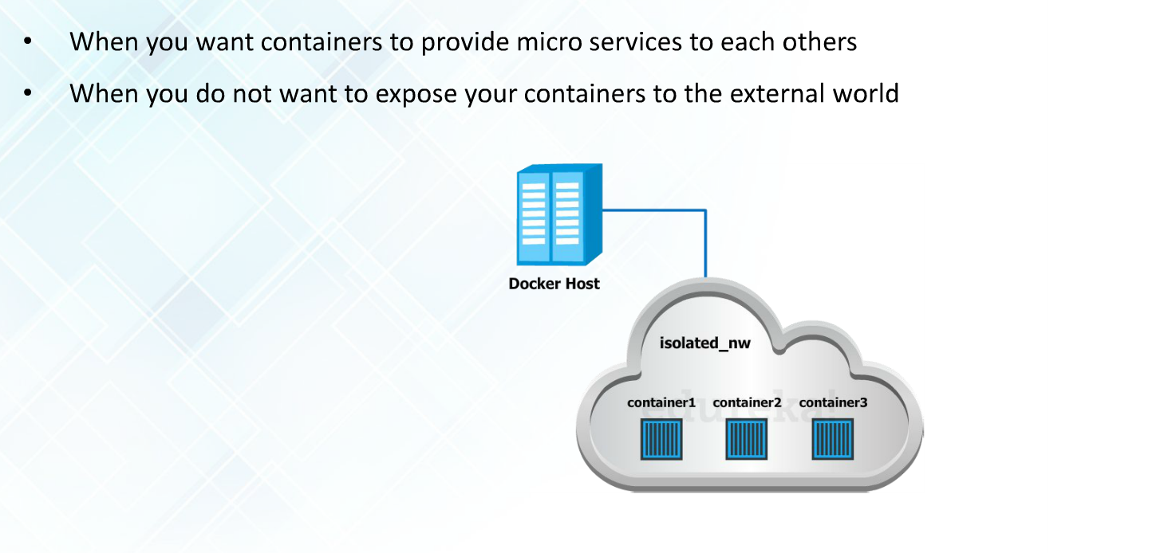
When to use Bridge Network

Slide 9
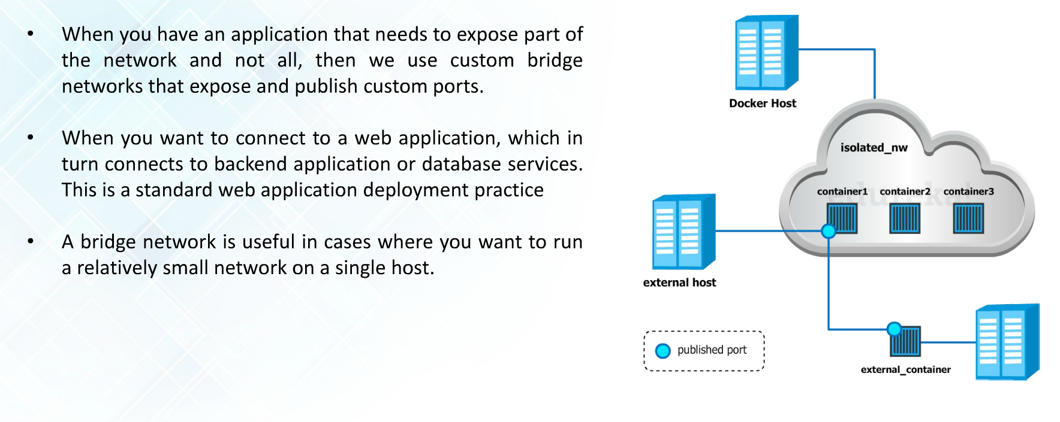
When to use User Defined Bridge Network

Slide 10
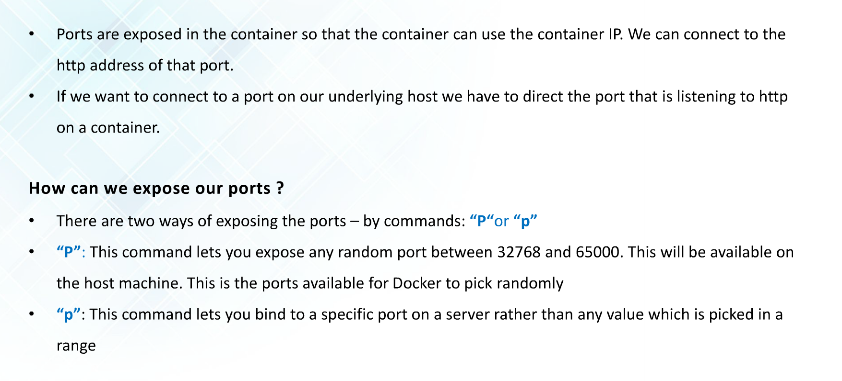
Ports

Slide 11
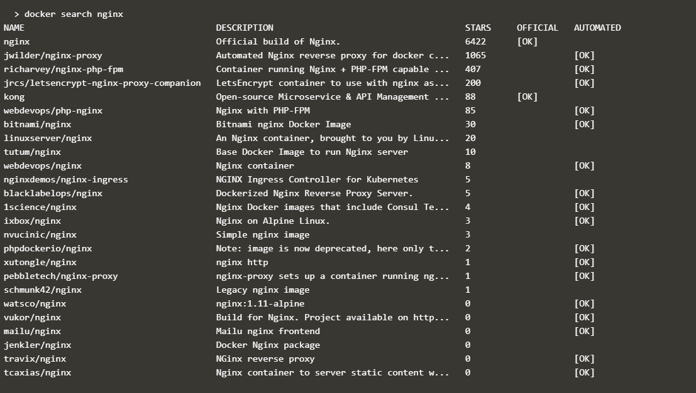
Example

Slide 12
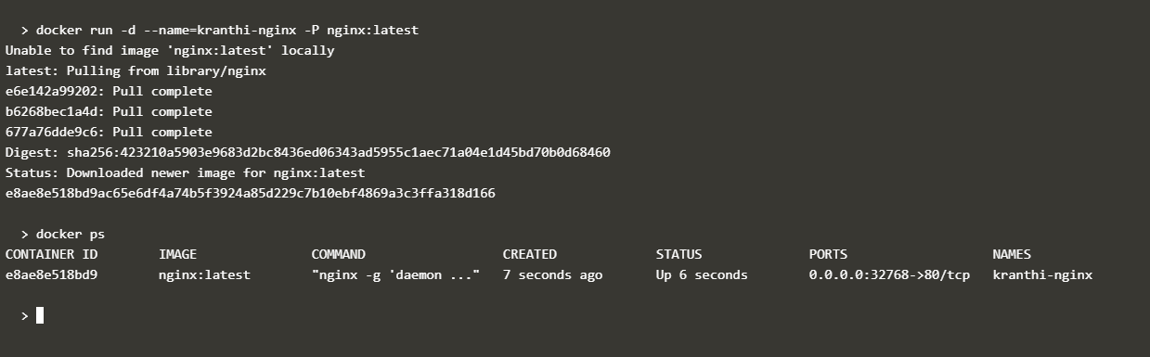

Slide 13
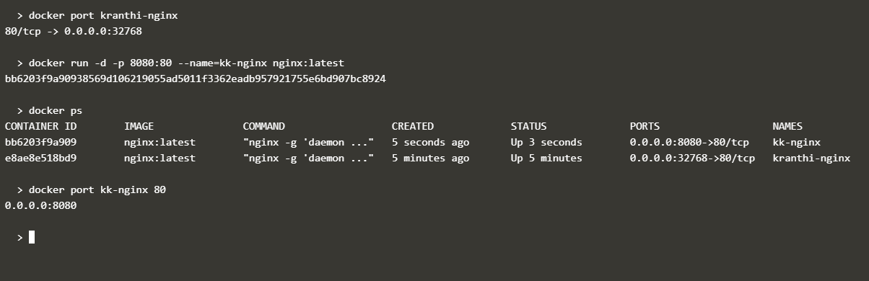
Getting ports

Slide 14
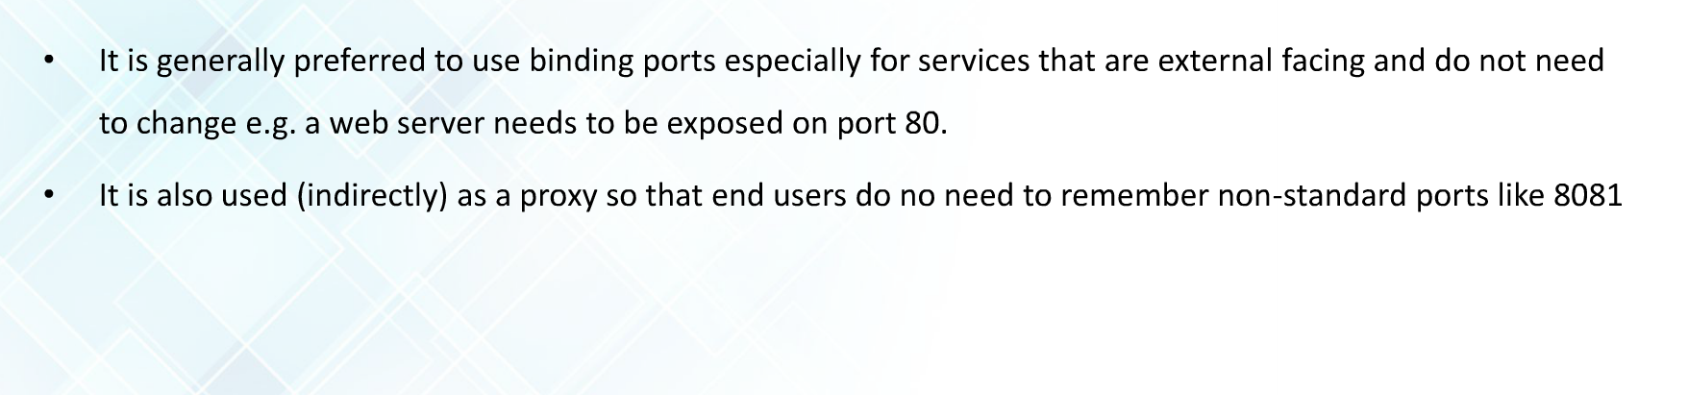
When to use binding ports

Slide 15
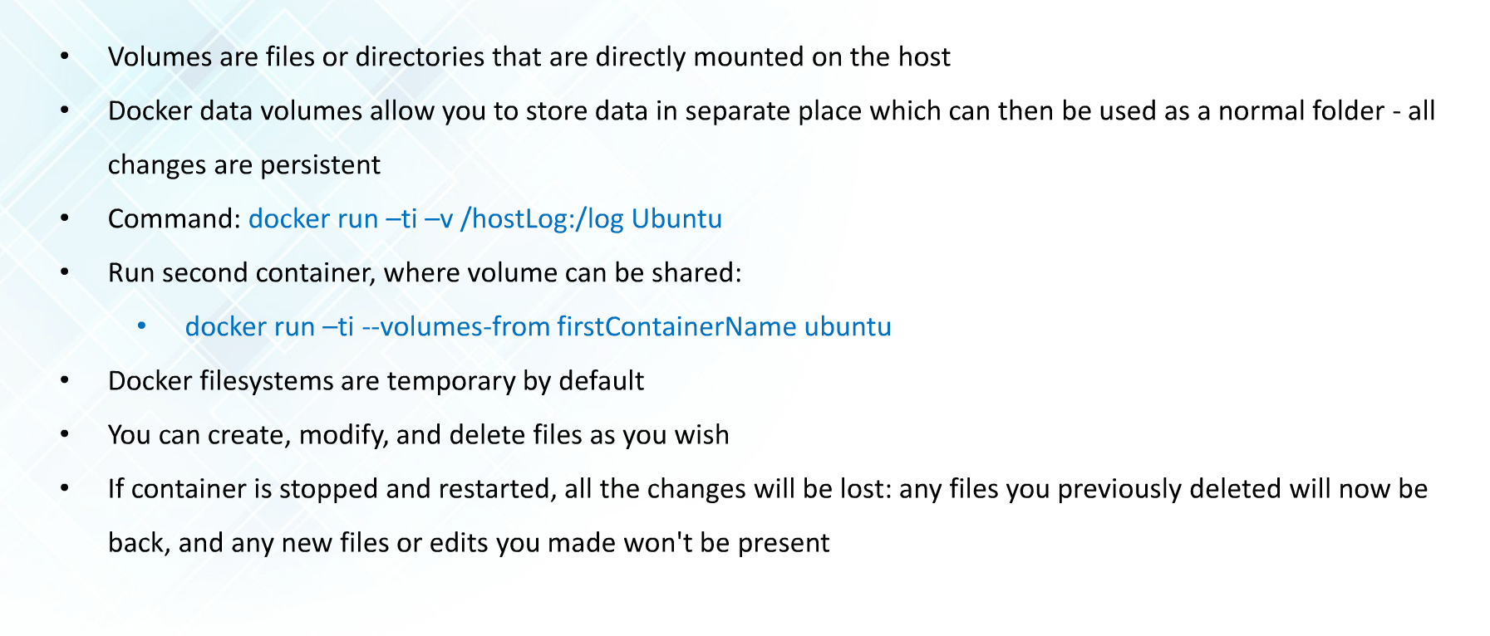
Docker Volumes

Slide 16
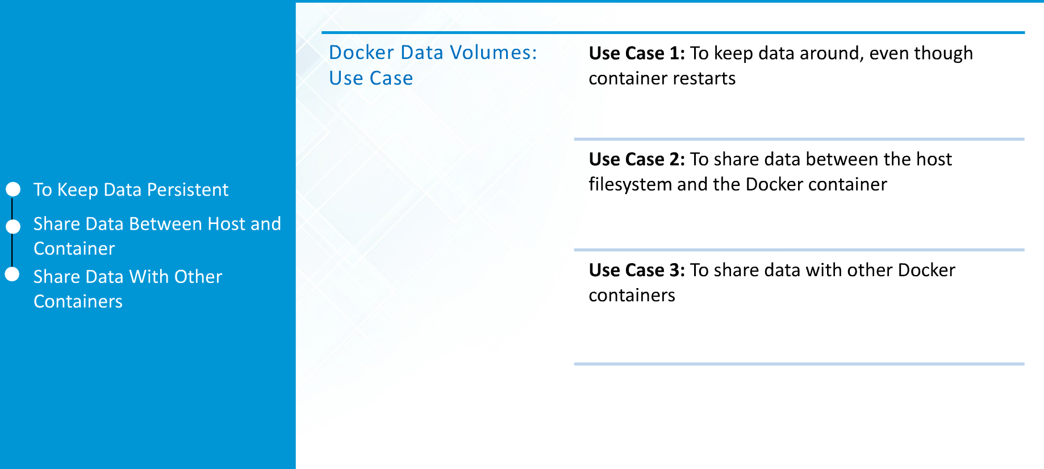
Docker Volumes

Slide 17
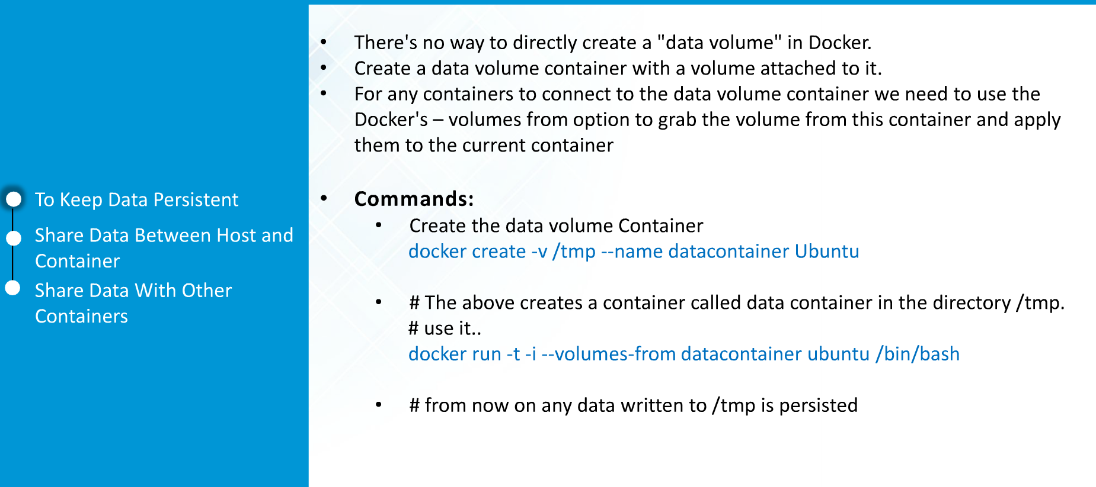
Volumes Use Cases

Slide 18
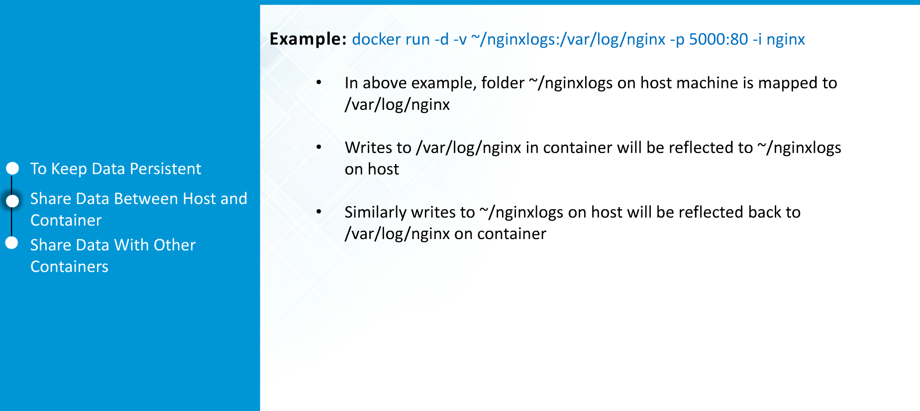

Slide 19
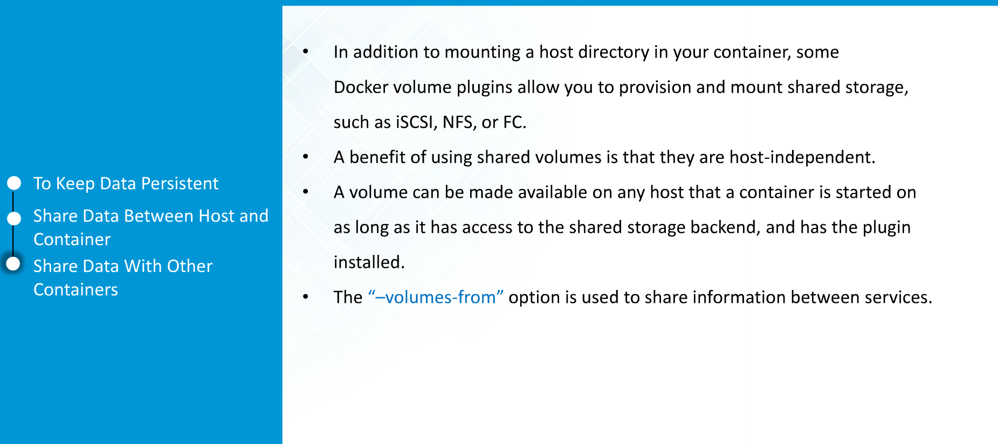

Slide 20
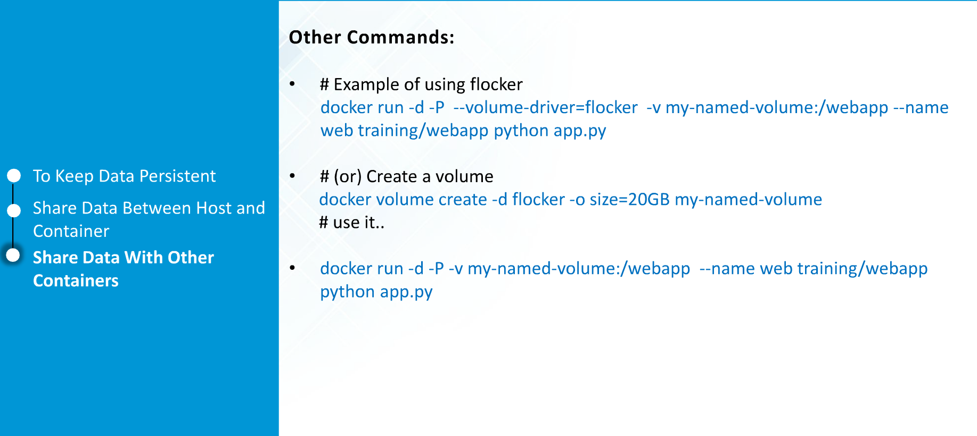

Slide 21
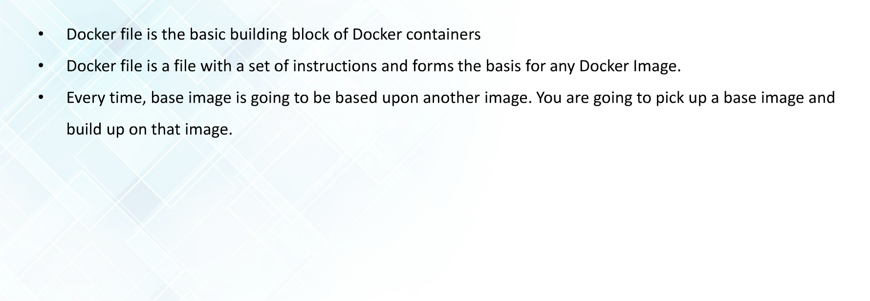
Docker File

Slide 22
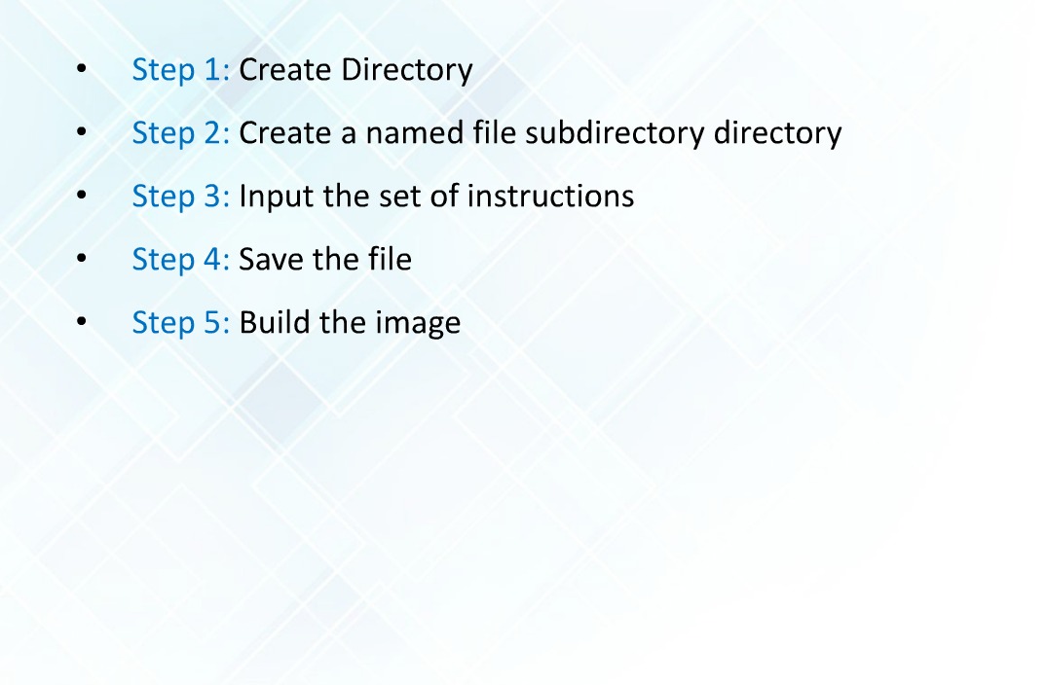
File creation steps

Slide 23
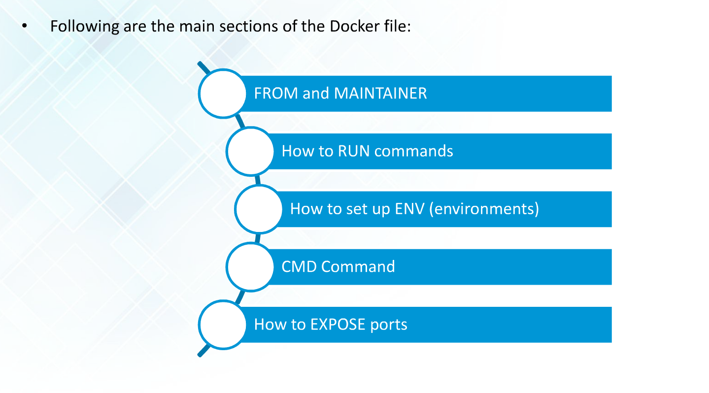
Docker File Sections

Slide 24
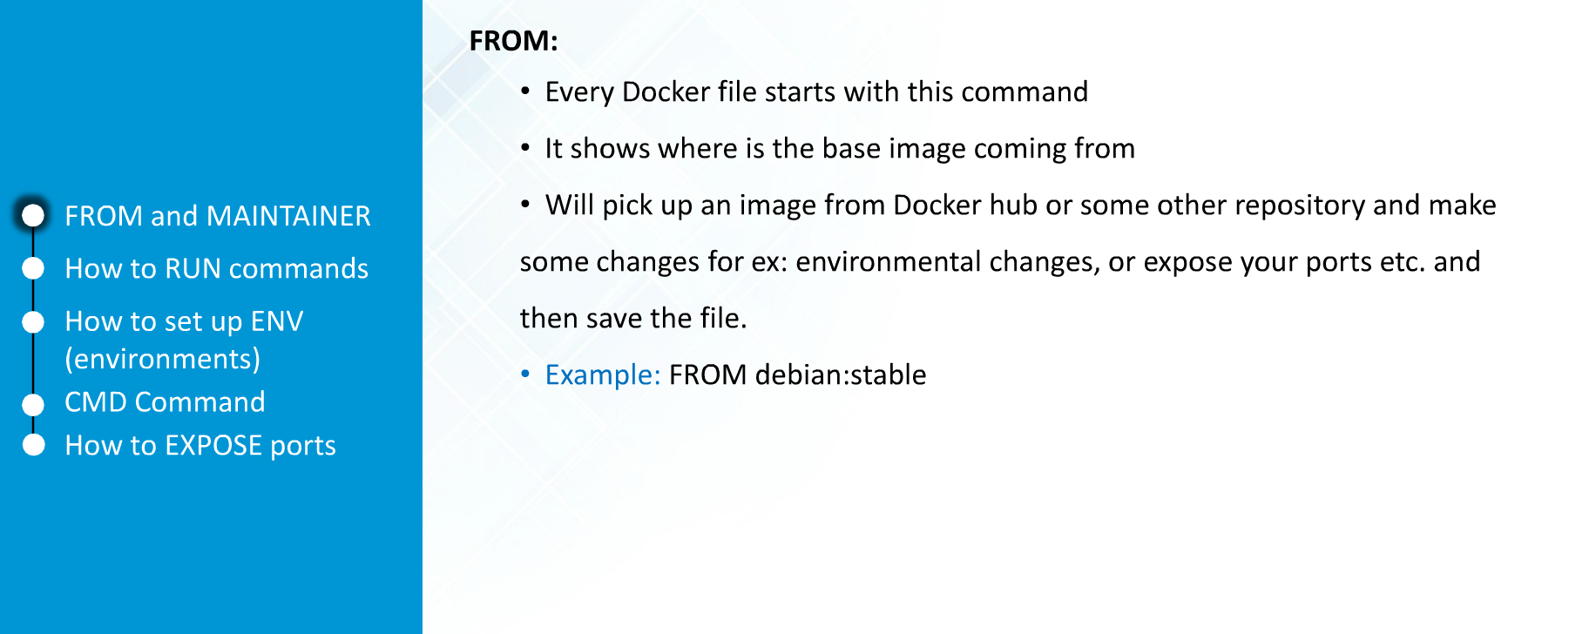
FROM

Slide 25
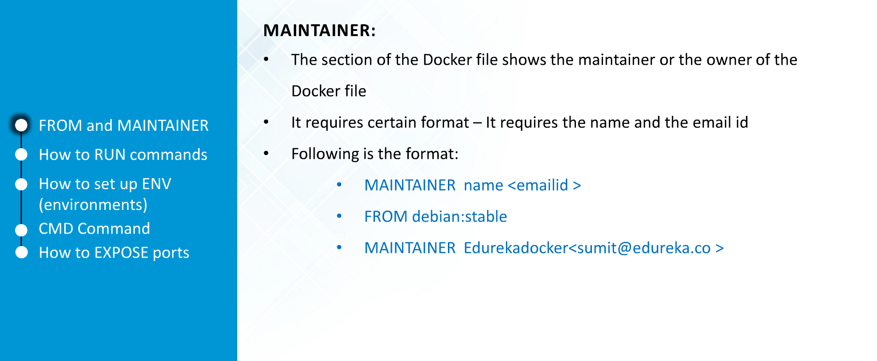
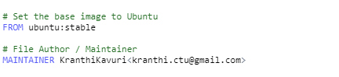
Maintainer

Slide 26
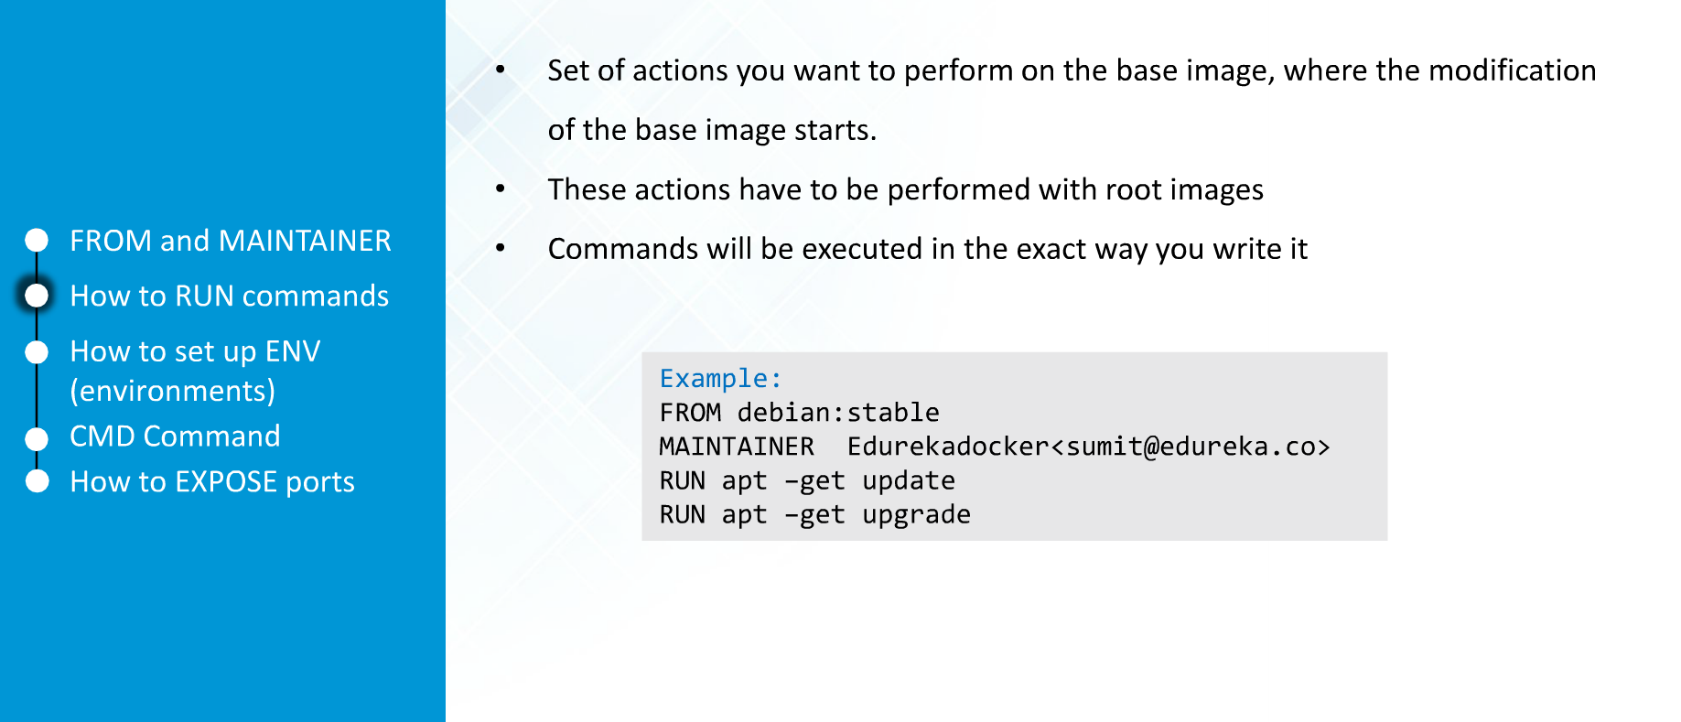
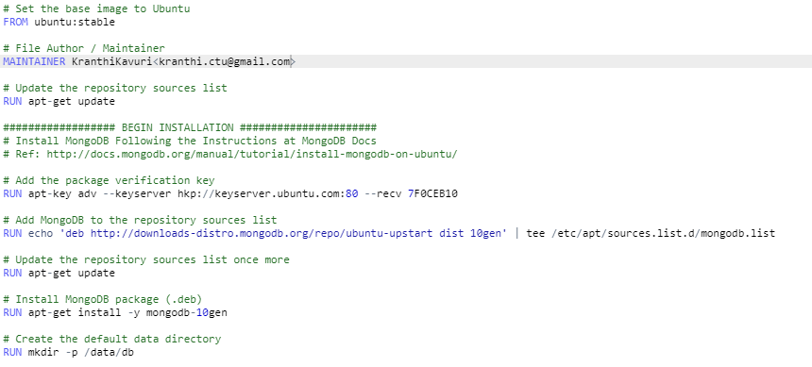
Run commands

Slide 27
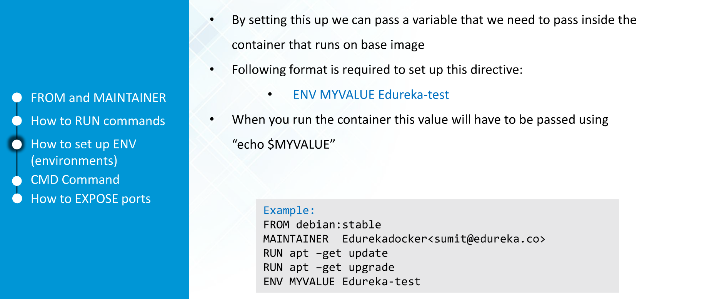
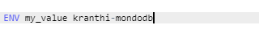
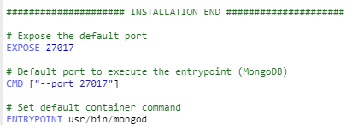
Environment Variables

Slide 28
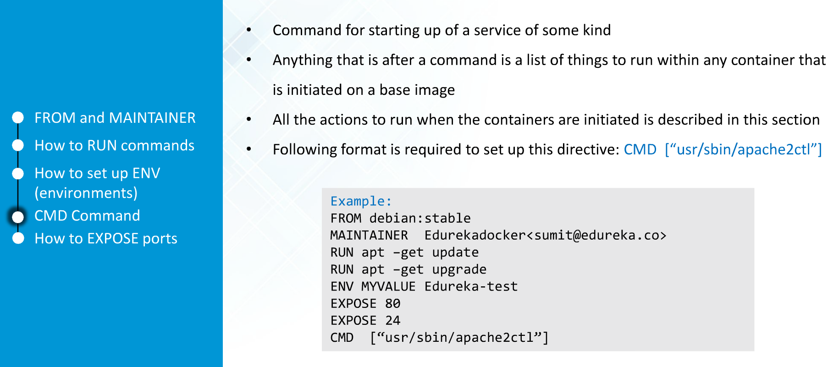
CMD

Slide 29
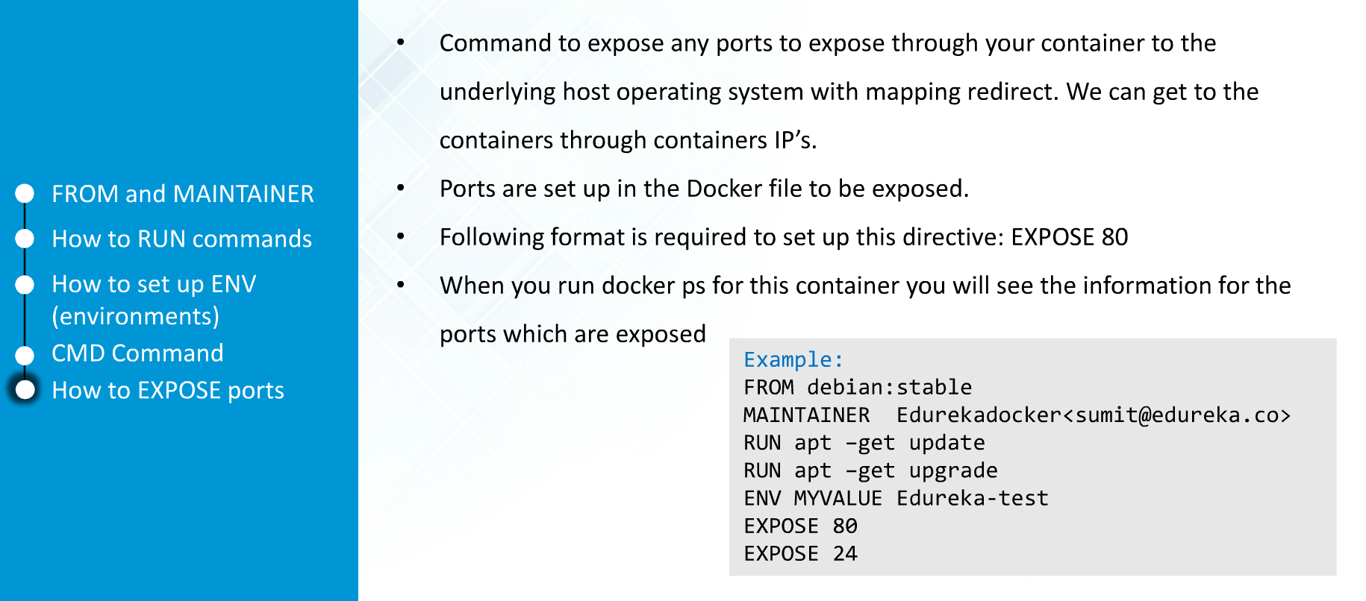
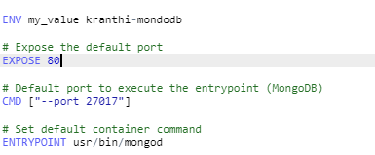
Expose Ports

Slide 30
Docker Assignment
cd ~
mkdir mongodb
cd mongodb
vi Dockerfile
Note: Copy and paste the following lines into the Dockerfile.

Slide 31
Docker file:
############################################################
# Dockerfile to build MongoDB container images
# Based on Ubuntu
############################################################
# Set the base image to Ubuntu
FROM ubuntu
# File Author / Maintainer
MAINTAINER KranthiKavuri<kranthi.ctu@gmail.com>
# Update the repository sources list
RUN apt-get update
################## BEGIN INSTALLATION ######################
# Install MongoDB Following the Instructions at MongoDB Docs
# Ref: http://docs.mongodb.org/manual/tutorial/install-mongodb-on-ubuntu/
# Add the package verification key
RUN apt-key adv --keyserver hkp://keyserver.ubuntu.com:80 --recv 7F0CEB10
# Add MongoDB to the repository sources list
RUN echo 'deb http://downloads-distro.mongodb.org/repo/ubuntu-upstart dist 10gen' | tee /etc/apt/sources.list.d/mongodb.list
# Update the repository sources list once more
RUN apt-get update
# Install MongoDB package (.deb)
RUN apt-get install -y mongodb-10gen
# Create the default data directory
RUN mkdir -p /data/db
##################### INSTALLATION END #####################
# Expose the default port
EXPOSE 27017
# Default port to execute the entrypoint (MongoDB)
CMD ["--port 27017"]
# Set default container command
ENTRYPOINT usr/bin/mongod

Slide 32
Build the Docker image
Note: Dockerfile should be saved after adding the above lines of code.
#Build the docker image with the following command:
docker build -t my_mongodb .
#Using the image we have build, we can now proceed to the final step: creating a container running a MongoDB instance inside, using a name of our choice (if desired with -name [name]).
sudo docker run -name my_first_mdb_instance -i -t my_mongodb

